Slide 1
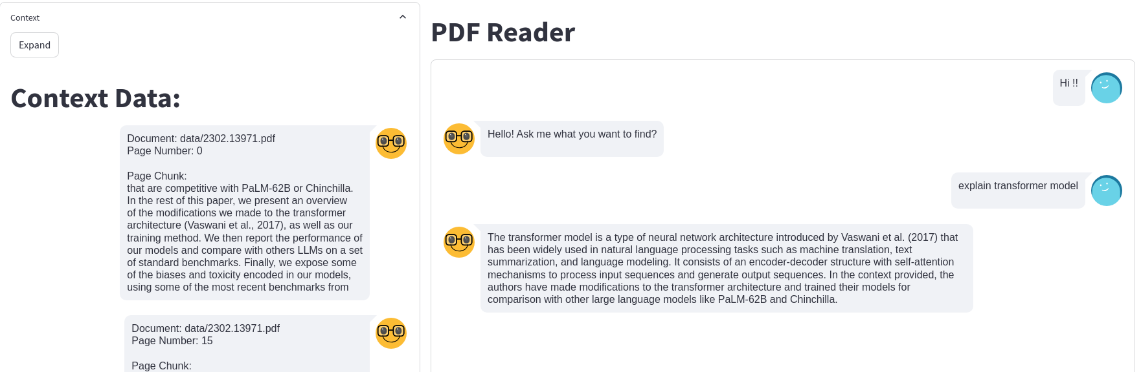
Doc Reader:
http://192.168.1.35:8501/

Slide 2
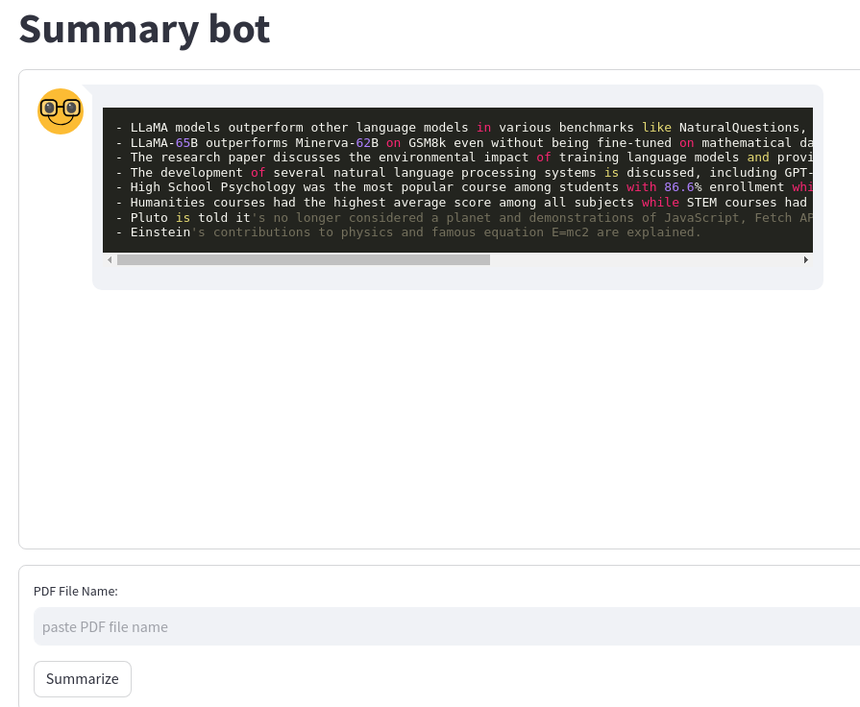
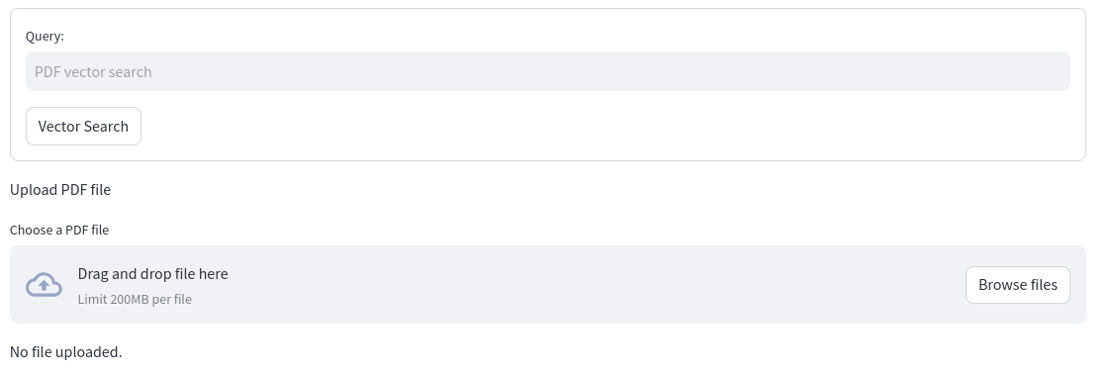

Doc Reader

Slide 3
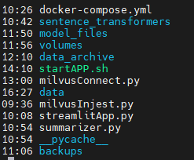
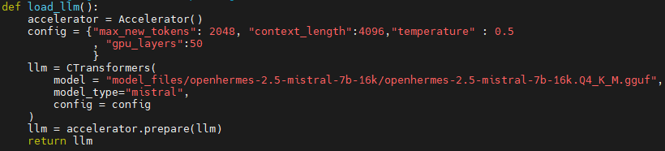
Doc Reader: Change LLM & Embedding Models

Slide 4
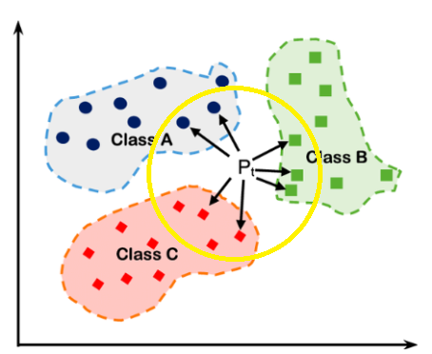

Summarizer: Best Representation Vectors
Brute Force Method: Map_reduce
Take X amount of data within context limit and summarize.

Slide 5
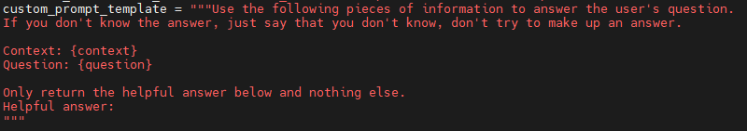
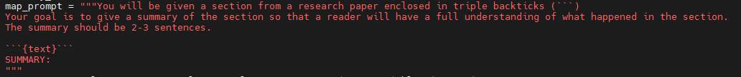
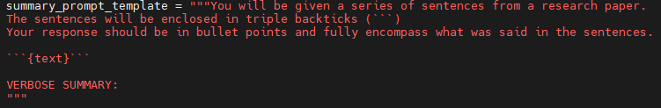
Summarizer : Prompt Engineering

Slide 6
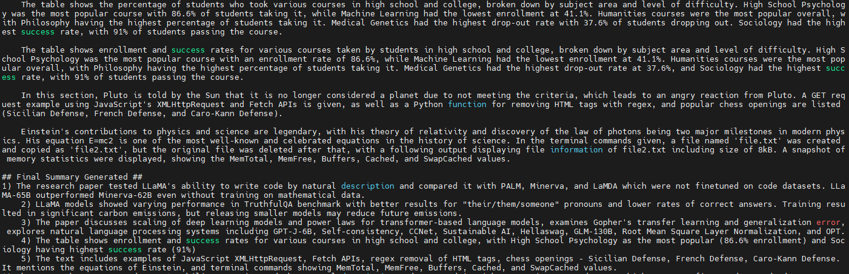
Summarizer

